Slide 1


IMAGE
Image , Image Processing Software and its types , Types of Image , Image Standard – JPEG , JPEG Compression and its steps
-Mahima Manni

Slide 2


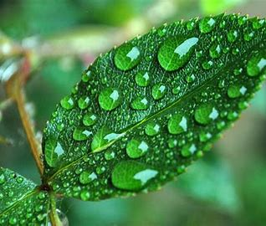
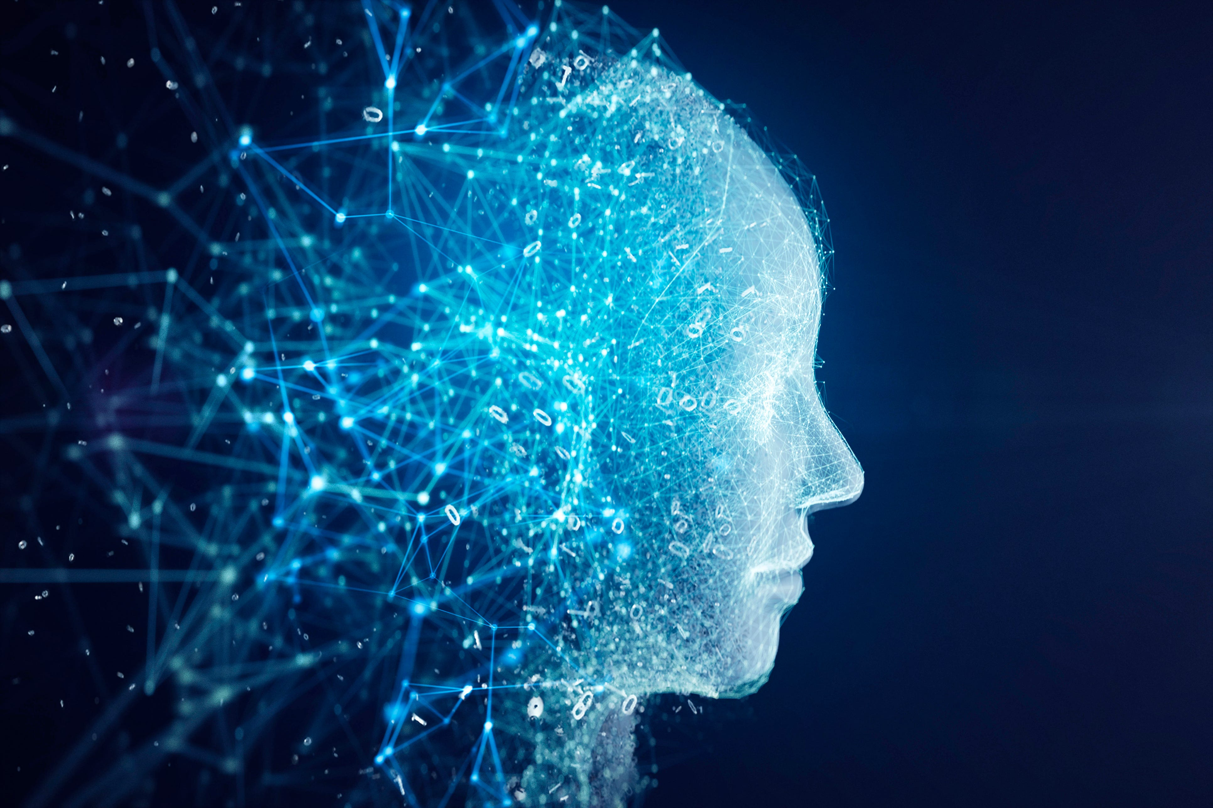
What is an Image?
An image consists of a rectangular array of dots called pixels. The size of the image is specified in terms of width X height, in numbers of the pixels. The physical size of the image, in inches or centimeters, depends on the resolution of the device on which the image is displayed.
The resolution is usually measured in DPI (Dots Per Inch). An image will appear smaller on a device with a higher resolution than on one with a lower resolution. For color images, one needs enough bits per pixel to represent all the colors in the image. The number of the bits per pixel is called the depth of the image.

Slide 3
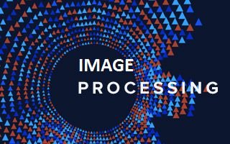
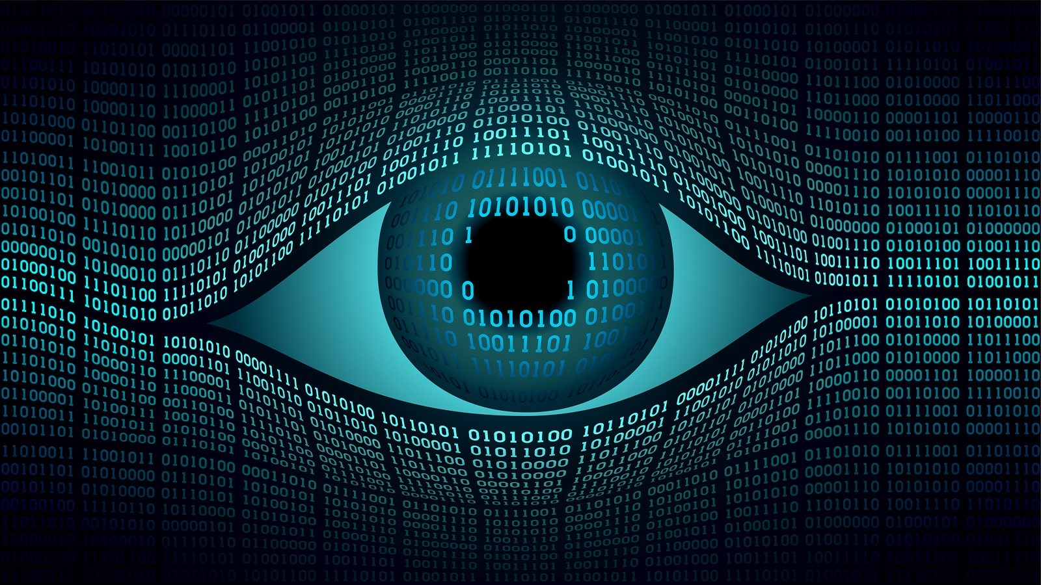
Image processing software
Image processing software is software that's designed to manipulate digital images. In particular, it captures the image if that hasn't already been done, it converts it to a digital form, and it performs a manipulation or manipulations on it. For example, have you ever seen someone lighten a photograph that was too dark? Or crop an image to remove unwanted background clutter. These are examples of image processing at work. Its purpose is to improve the contents and quality of an image.
I
M
A
G
E

Slide 4
Types of Image Processing Software
It seems like there is image processing software for just about any application you can think of. Not surprising really, because it contributes to so many areas. Instead, let's talk about some of the categories, or types, they fall into.
1. Computer Graphics
We don't often think of computer graphics as image processing because it processes 2D and 3D image definition files rather than the resulting images themselves. It's a fine point but worthy of note. Examples include maps, posters, videos, and movies.
2. Computer Vision
This type focuses on processing that helps the software recognize objects within the viewing area. For example, some factories use computer vision to determine if particular steps in their process have been completed successfully.
3. Medical Imaging
This type focuses on processing that helps with issue detection and diagnosis. Examples include bioimaging (non-invasive visualization of biological processes) and neuroimaging (visualization of the nervous system).
4. Photo Editing
This type focuses on processing that helps improve photographs, like changing the brightness, contrast, or color skew, for example, when you brighten an overly dark photograph or crop out background clutter.

Slide 5
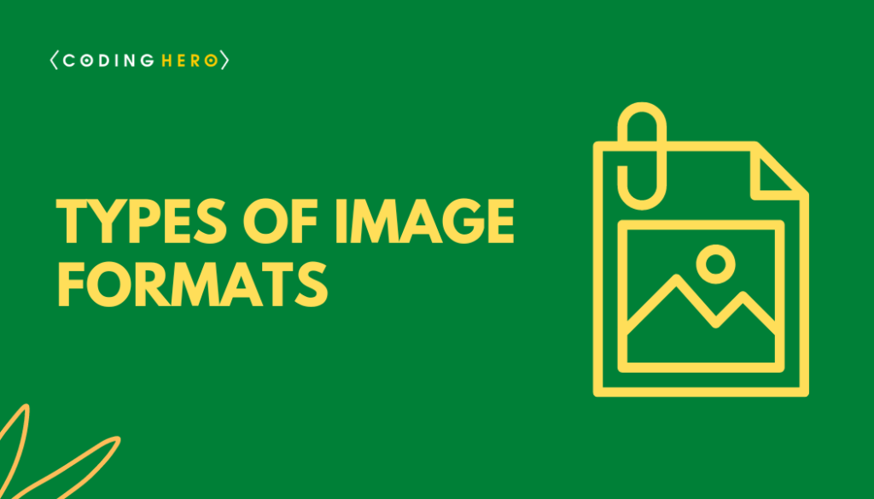
TYPES OF IMAGES
There are many type of images, and we will look in detail about different types of images, and the color distribution in them.

Slide 6
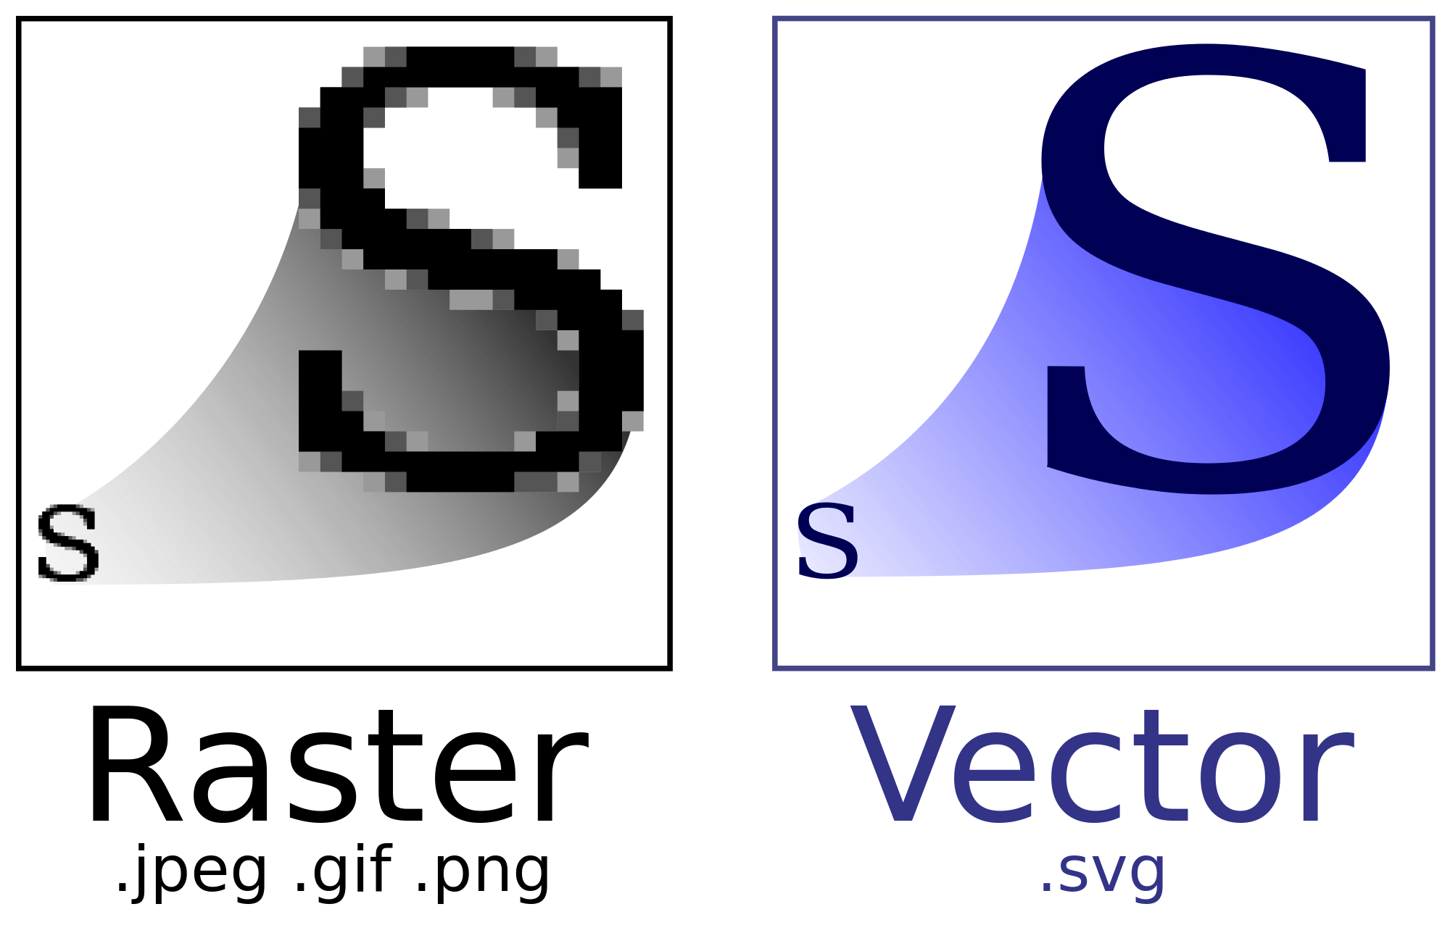

Vector Image Files
Vector images are far more flexible. They are constructed using proportional formulas rather than pixels. EPS, AI, and PDF are perfect for creating graphics that require frequent resizing. Your logo and brand graphics should have been created as a vector, and you should always have a master file on hand
. The real beauty of vectors lies in their ability to be sized as small as a postage stamp, or large enough to fit on a billboard!

Slide 7

JPEG – Joint Photographic Experts Group
JPEGs might be the most common file type you run across on the web, and more than likely the kind of image that is in your company’s MS Word version of its letterhead. JPEGs are known for their “lossy” compression, meaning that the quality of the image decreases as the file size decreases.
You can use JPEGs for projects on the web, in Microsoft Office documents, or for projects that require printing at a high resolution. Paying attention to the resolution and file size with JPEGs is essential in order to produce a nice-looking project.

Slide 8


Graphics Interchange Format (GIF)
This format was developed by CompuServe and first released under the standard GIF87a in 1987 and two years later extended to GIF89a. Interesting features of the GIF format are the capabilities for animations (using multiple images) and for transparency. The typical structure of a GIF file is as follows :
GIF header block;
logical screen descriptor block;
global color map (optional);
extension blocks (optional);
image area (repeated for each image)
Due to the limited number of colors, the file size is drastically reduced.

Slide 9
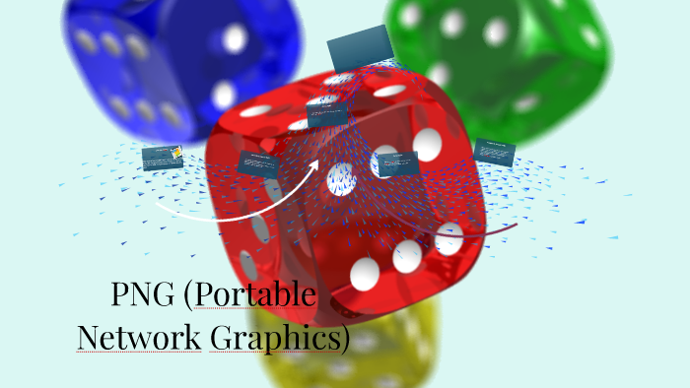
PNG – Portable Network Graphics
PNGs are amazing for interactive documents such as web pages but are not suitable for print. While PNGs are “lossless,” meaning you can edit them and not lose quality, they are still low resolution.
The reason PNGs are used in most web projects is that you can save your image with more colors on a transparent background. This makes for a much sharper, web-quality image.

Slide 10
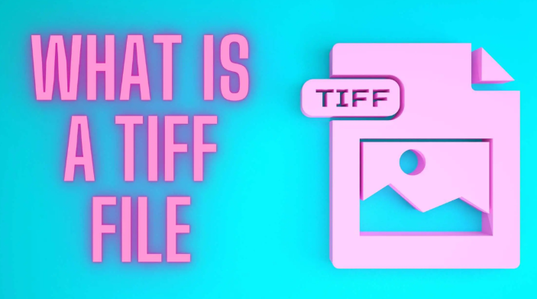

TIFF – Tagged Image File
A TIFF is a large raster file that doesn’t lose quality. This file type is known for using “lossless compression,” meaning the original image data is maintained regardless of how often you might copy, re-save, or compress the original file.
Despite TIFF images’ ability to recover their quality after manipulation, you should avoid using this file type on the web. Since it can take forever to load, it’ll severely impact website performance. TIFF files are also commonly used when saving photographs for print.

Slide 11
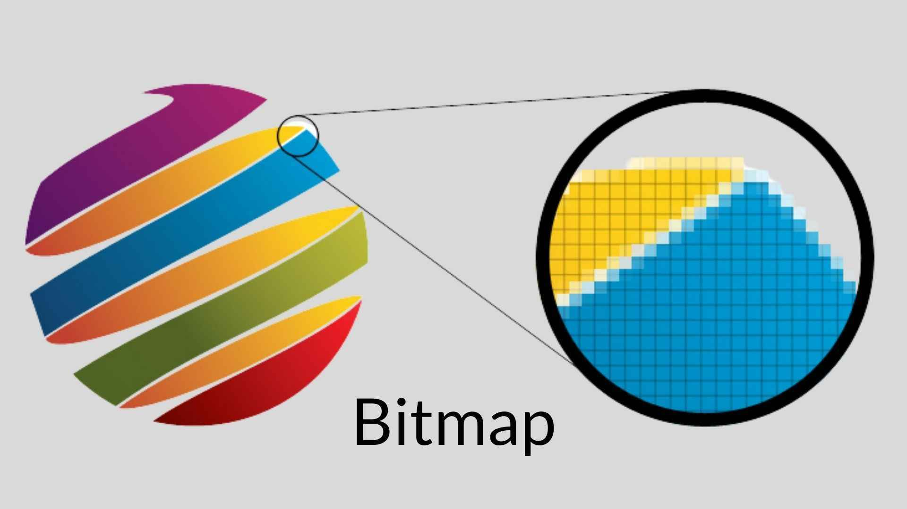
BMP – Bit Map Image File
The next in the list of types of images are BMP files. Files have extensions .BMP represents Bitmap Image files that are used to store bitmap digital images. These images are independent of the graphics adapter and are also called device-independent bitmap (DIB) file format. The BMP file format can store data as two-dimensional digital images in both monochromes as well as color formats with various colour depths.

Slide 12
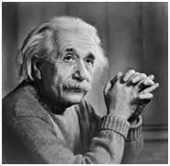
8 bit color format
8 bit color format is one of the most famous image format. It has 256 different shades of colors in it. It is commonly known as Grayscale image.
The range of the colors in 8 bit vary from 0-255. Where 0 stands for black, and 255 stands for white, and 127 stands for gray color.
This format was used initially by early models of the operating systems UNIX and the early color Macintoshes.
A grayscale image of Einstein is shown below:

Slide 13
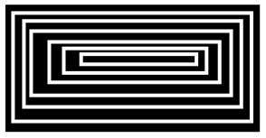
Black and white image:
The resulting image that is formed hence consist of only black and white color and thus can also be called as Black and White image.

Slide 14
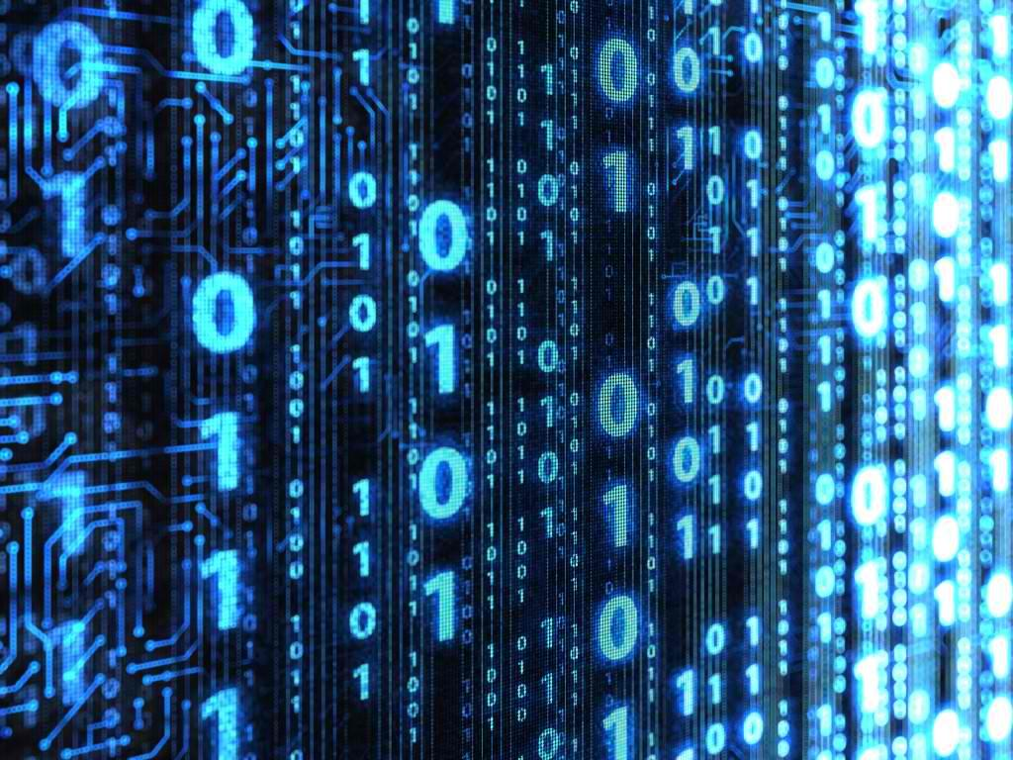
The binary image
The binary image as it name states, contain only two pixel values 0 and 1.
Here 0 refers to black color and 1 refers to white color. It is also known as Monochrome.

Slide 15
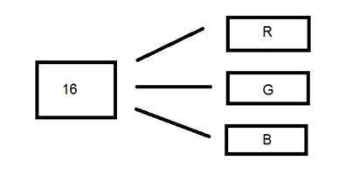
16 bit color format
It is a color image format. It has 65,536 different colors in it. It is also known as High color format.
The distribution of color in a color image is not as simple as it was in grayscale image.
A 16 bit format is actually divided into three further formats which are Red , Green and Blue. The famous (RGB) format.
It is pictorially represented in the image below.

Slide 16
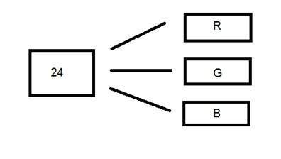
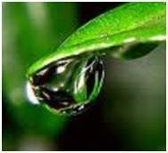
24 bit color format
24 bit color format also known as true color format. Like 16 bit color format, in a 24 bit color format, the 24 bits are again distributed in three different formats of Red, Green and Blue.
Since 24 is equally divided on 8, so it has been distributed equally between three different color channels.
Their distribution is like this 8 bits for R, 8 bits for G, 8 bits for B.
Behind a 24 bit image.
Unlike a 8 bit gray scale image, which has one matrix behind it, a 24 bit image has three different matrices of R, G, B.

Slide 17
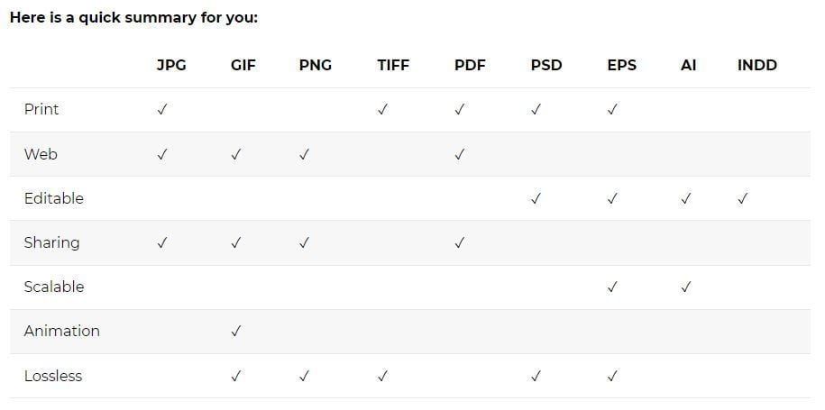

Slide 18
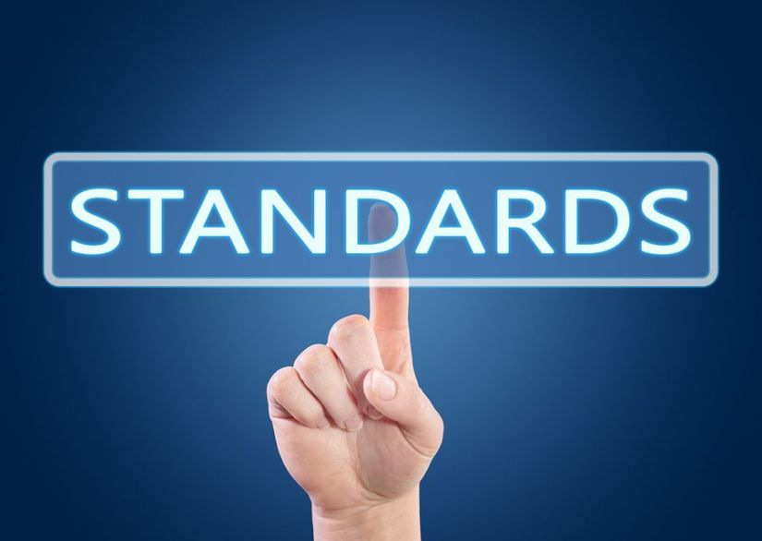

Slide 19
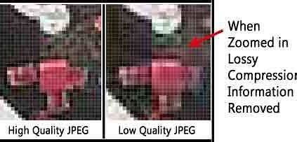
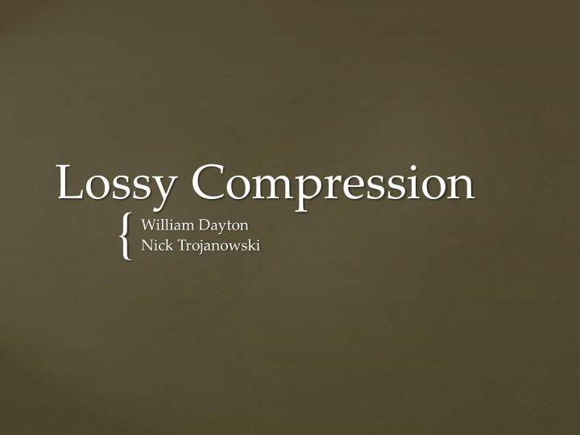
Lossy Image Compression
Lossy image compression is a widely used method to reduce the size of pictures. This process compresses the image file size by permanently discarding some of its information, specifically redundant data. The method certainly reduces the image’s size, but the picture’s quality may also get affected, especially if the picture is overly compressed.
Another significant drawback of lossy compression is that it’s irreversible. Once you compress the image using lossy compression, the picture can never be restored to its previous state. Moreover, the image can be distorted if you repeatedly apply lossy compression. Therefore, the use of lossy compression is ideal for web-based platforms where the low quality of image degradation can often be accepted.

Slide 20
Image Compression Standard
One of the most common examples of lossy compression is the JPEG format. This image compression format is widely used on the web. Digital photographers also use this format for image compression. Many tools and applications support this image compression format. JPEG compression uses the Discrete Cosine Transform method for performing the modification. Moreover, the JPEG format also allows adjustment between storage sizes. The degree of compression can also be altered in this compression method.

Slide 21
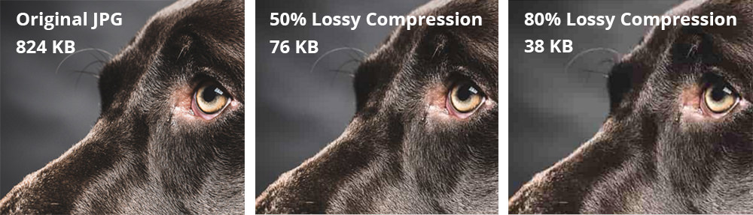

Slide 22
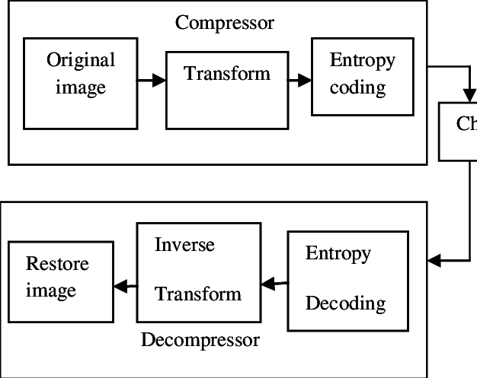
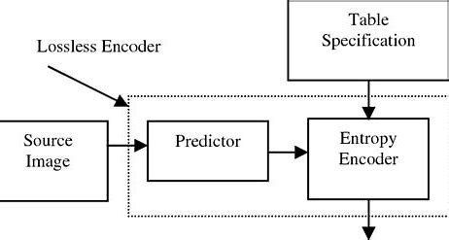
Lossless Image Compression
The other way of image compression is known as lossless compression. In this approach, the compression applies without affecting the quality of the image. There is no loss of information associated with this compression method. Moreover, the compressed image can also restore to its original state without any degradation or distortion.
But, it is important to state here that lossless image compression doesn’t reduce the size of an image equal to lossy compression. Lossless image compression is mostly preferred when the quality of the image is more important than storage space, like the images of different products on an online store.

Slide 23
Image Compression Standards
One of the most prominent lossless image compression is PNG. This format is highly appreciated because it shrinks image file size by classifying designs and compressing those patterns. There is no doubt that PNGs are larger than JPEGs in size. Still, websites use them when extensive image data is required. For example, logos, visual icons, screenshots, and transparent images are often created in this image format. There are many other familiar lossless compression formats available like BMP and GIF that are widely preferred for compressing pictures.

Slide 24
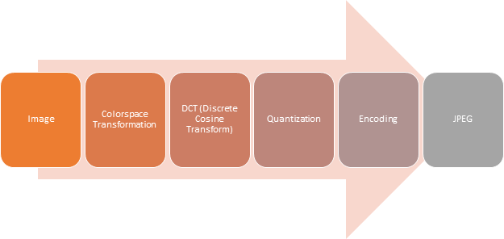
Steps in JPEG Compression
Splitting – We split our image into the blocks of 8*8 blocks. It forms 64 blocks in which each block is referred to as 1 pixel.
2.Color Space Transform – In this phase, we convert R, G, B to Y, Cb, Cr model. Here Y is for brightness, Cb is color blueness and Cr stands for Color redness. We transform it into chromium colors as these are less sensitive to human eyes thus can be removed.

Slide 25
3.Apply DCT – We apply Direct cosine transform on each block. The discrete cosine transform (DCT) represents an image as a sum of sinusoids of varying magnitudes and frequencies.
4.Quantization – In the Quantization process, we quantize our data using the quantization table.
5.Serialization – In serialization, we perform the zig-zag scanning pattern to exploit redundancy.

Slide 26
6.Vectoring – We apply DPCM (differential pulse code modeling) on DC elements. DC elements are used to define the strength of colors.
7.Encoding – In the last stage, we apply to encode either run-length encoding or Huffman encoding. The main aim is to convert the image into text and by applying any encoding we convert it into binary form (0, 1) to compress the data.

Slide 27
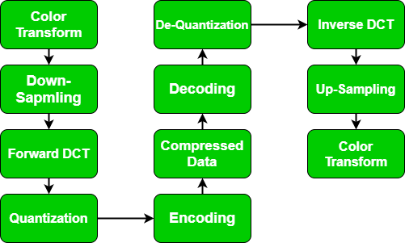

Slide 28


